Slide 1


Recommender
Systems
Presented by Tanvir Deol
ts3deol@uwaterloo.ca
Notebook Link Here

Slide 2
Workshop Overview
Prereqs:
Some basic ML knowledge
Basic Linear Algebra
Goals:
Start with basic architectures and build our way up in complexity
Basic Models
Models currently used in Industry
Emerging Architectures
Implement our own recommendation systems

Slide 3
Workshop Outline
What are Recommender Systems?
Motivation
History Timeline
Level 1: Basic Models
Content Based Filtering (KNN)
Collaborative Filtering (Matrix Factorization)
Level 2: Industry Models
Neural Collaborative Filtering
Level 3: Emerging Architectures
Graph Neural Networks
Notebook
Useful Resources

Slide 4
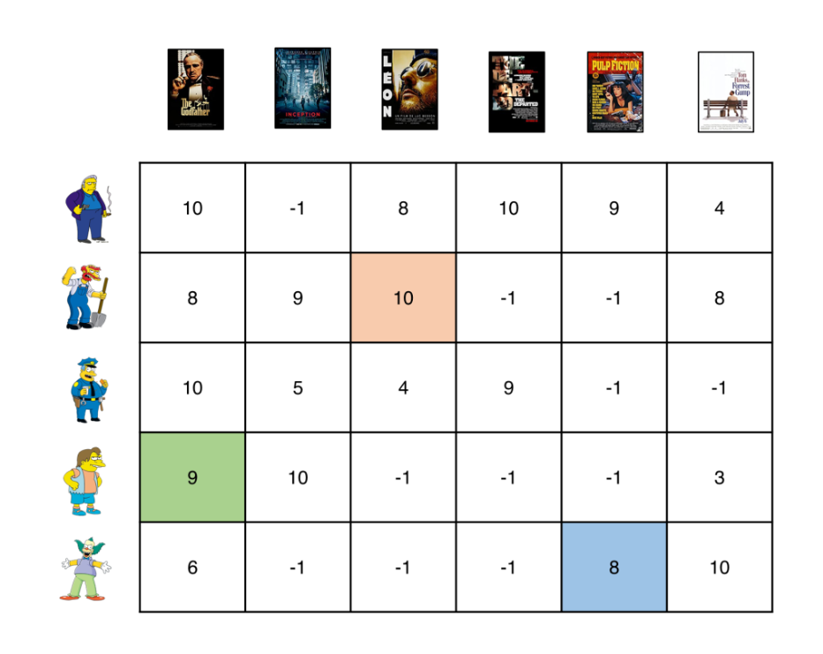
What are Recommender Systems?
Recommender Systems (Rec Sys) are a class of ML model made to provide personalized recommendations relevant to users
Terminology:
Items - Info about objects being recommended (e.g. movies)
Users - Info about users
Embeddings - Representations of a user/items in a N-dimensional vector
Items j
Users
i
How much user i ‘likes’ item j

Slide 5
Motivation
Rec Sys are one of the most relevant ML topics to industry
They are a core aspect of revenue-generation for many B2C tech companies
Aim to maximize customer retention
Facts:
Rec Sys are responsible for 35% of Amazon.com’s revenue
80% of Netflix stream time comes from its recommendations
Examples in Industry:
Amazon.com Products
Netflix Movies
Youtube Home page
Instagram Explore Page
Steam Explore Page
And so on …

Slide 6
History Timeline
Industry Models
Emerging
Architectures
Basic Models
Neural Collaborative Filtering
Reinforcement Learning,
Graph Neural Networks …
Content Based Filtering
Collaborative Filtering
Matrix Factorization
1990
2000
2010
2020

Slide 7
Level 1 - Content Based Filtering
Defn: Recommending similar items to what the user likes
Ex - Video Game Recommendations
Features
Features
F1 F2 F3
F1 F2 F3
Feature Labels:
F1 - FPS
F2 - Adventure
F3 - Sports
User 1
0 4 9
Item 1
5 5 2
User 2
6 2 1
Item 2
9 7 9
User 3
7 3 5
Item 3
0 3 8

Slide 8
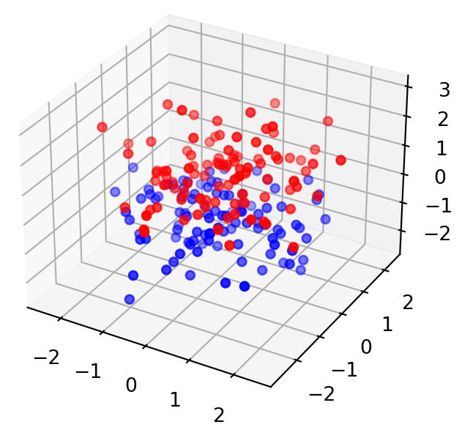
Level 1 - Content Based Filtering
Given the user + item embeddings we can represent them in a N dimensional space:
Red Points - Users
Blue Points - Items
The Rec Sys has to find the most similar items for user i using a similarity metric that measures distance between embeddings/points

Slide 9
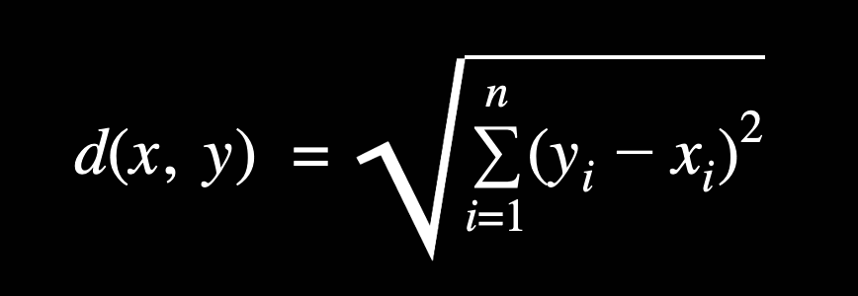
Level 1 - Content Based Filtering
Similarity Metric: Euclidean Distance
Magnitude of a straight line between two points in a N-dimensional space
Find Similar Points: K-Nearest Neighbors (KNN)
Precision @ K:
(# of relevant items at K)
Initialize value of K
For every item embedding:
Calculate distance between item and user i
Find the K smallest calculated distances
The corresponding items are your “similar items”
K

Slide 10
Level 1 - Content Based Filtering
Pros
Cons
Easy to understand + High interpretability
Scalable for lots of users (since users treated independently)
Needs hand-engineered features beforehand
Needs information for each user and item beforehand (expensive & infeasible)

Slide 11
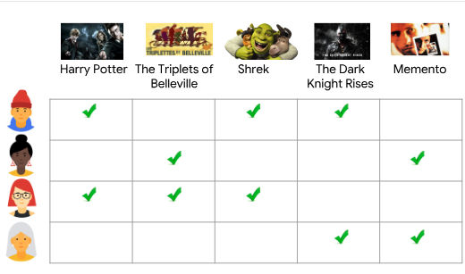
Level 1 - Collaborative Filtering
Defn: Recommending items based on what similar users like
Feedback Matrix A_{MxN}
A_{i,j} = 1 → User i interested in item j
A_{i,j} = 0 → User i not interested in item j (or unobserved)

Slide 12
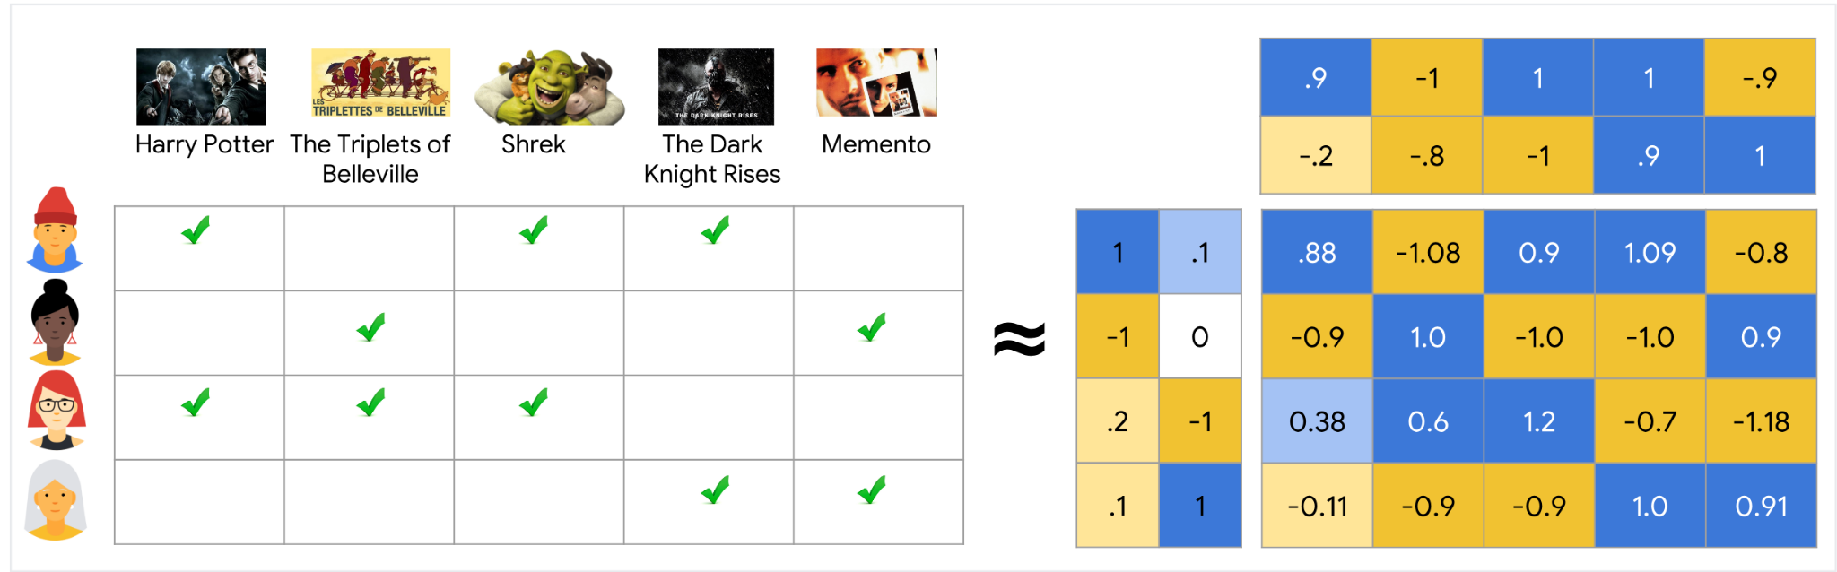
Level 1 - Collaborative Filtering
Item Embedding Matrix
V
A
U
UV^{T}
Feedback Matrix
User Embedding Matrix

Slide 13
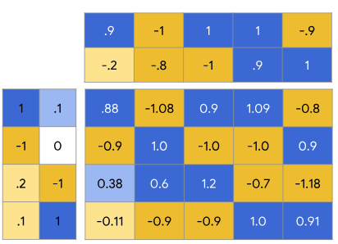

Level 1 - Collaborative Filtering
Matrix Factorization:
Finds user matrix U and item matrix V that minimizes the function
V
Ways to solve
Singular Value Decomposition
(too slow)
Stochastic Gradient Descent
U
UV^{T}

Slide 14
Level 1 - Collaborative Filtering
Pros
Cons
Don't need to specify features beforehand
No domain knowledge required
Makes use of all data available for predictions
Unable to capture non-linear relationships between users and items
(Since UV^{T} is made up of weighted sums)

Slide 15
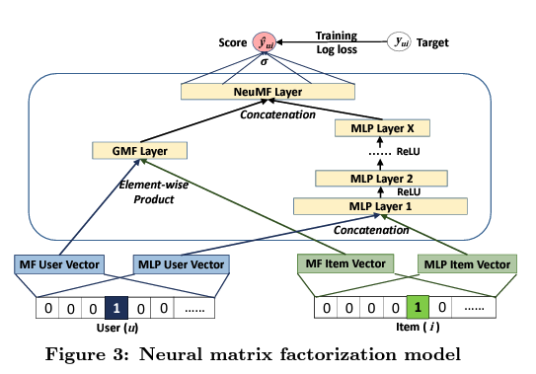
Level 2 - Neural Collaborative Filtering
Was the next breakthrough in RecSys in 2017
Kickstarted the use of Deep Learning (Neural Networks) in Rec Sys.
Made the upgrade from the previous industry standard: Matrix Factorization

Slide 16
Level 2 - Neural Collaborative Filtering
Purpose:
Model predicts interaction score between user u and item j
Predicted score is denoted ŷ_{ui}

Slide 17
Level 2 - Neural Collaborative Filtering
Input Layer:
IDs of (user, item) pair in sparse one hot encoded form
Ex:
4 → [0,0,0,1,0,0, …]
5 → [0,0,0,0,1,0, …]

Slide 18
Level 2 - Neural Collaborative Filtering
Embedding Layer:
The inputs converted to their corresponding embeddings from matrix factorization model
Embedding of user ID 3 below
V
U
UV^{T}

Slide 19
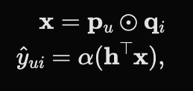
Level 2 - Neural Collaborative Filtering
Generalized Matrix Factorization Layer:
p_{u} = embedding for user u
q_{i} = embedding for item i
x = resulting input vector
a = activation function of NN
h = weights of NN
ŷ_{ui} = prediction for user u, item i

Slide 20
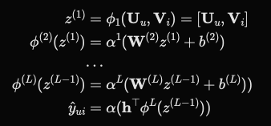
Level 2 - Neural Collaborative Filtering
Multi-Layer Perceptron Layer:
Responsible for capturing the non-linear patterns
W - weight matrix
b - bias vector
a - activation function
Φ - function of labelled layer
z - output of labelled layer
ŷ_{ui} = prediction for user u, item i

Slide 21

Level 2 - Neural Collaborative Filtering
NeuMF Layer:
Combines results both networks
Concatenates the second last layers of the GMF and MLP networks to get:
σ - sigmoid activation function
h - projection matrix
ŷ_{ui} = prediction for user u, item i

Slide 22
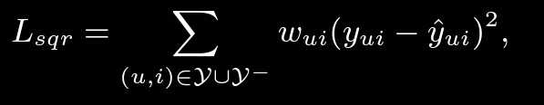
Level 2 - Neural Collaborative Filtering
Loss Score:
Neural Collaborative Filtering uses pointwise loss:
y - set of observed interactions
y⁻ - set of unobserved interactions
w_{ui} - weight hyperparameter
y_{ui} - target
ŷ_{ui} - prediction

Slide 23
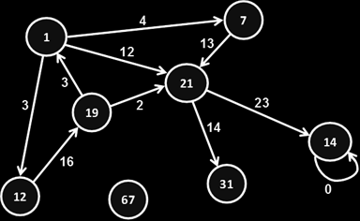
Level 3 - Graph Neural Networks
Graph Based methods help capture more complex relational dependencies in the data, and have been gaining popularity since 2020
Work well for data with relational dependencies
Social Media networks (mutual friends)
Large Knowledge Graphs
Citation Networks

Slide 24
Level 3 - Graph Neural Networks
Amazon - “Using graph neural networks to recommend related products”
Using GNNs to model asymmetric product relationships leading to 30-160% performance improvements
Snap Inc - “Graph Neural Networks for Friend Ranking in Large-scale Social Platforms”
Propose GNN model that uses messages, likes, & other interactions to generate higher quality user representations
Google Maps - “ETA Prediction with Graph Neural Networks in Google Maps”
Use GNN to model connectivity of road networks to reduce inaccuracies of ETA calculations by more than 50%

Slide 25
Notebook
We will show how to implement basic recommender systems based on the ideas covered today
Content-Based Filtering (KNN method)
Collaborative Filtering (Matrix Factorization method)
Neural Collaborative Filtering

Slide 26
Useful Resources
Datasets:
Recommender System Datasets
Stanford Graph/Recommendation Datasets
Netflix $1M Prize Competition Dataset
Architectures:
Intro to Content-Based Filtering
Intro to Collaborative Filtering
Neural Collaborative Filtering Paper (2017)
Future of Recommendation Systems:
Amazon Science: GNNs for related products
Snap Inc: GNNs for Large Scale Friend Ranking
Google Maps: ETA Prediction using GNNs

